Slide 1
Introduction to Analytics Dept.
TIGERRISK PARTNERS

Slide 2
Analytics Department: Broad Functional Divisions
Actuarial
Catastrophe Modeling
Rating Agency Support

Slide 3
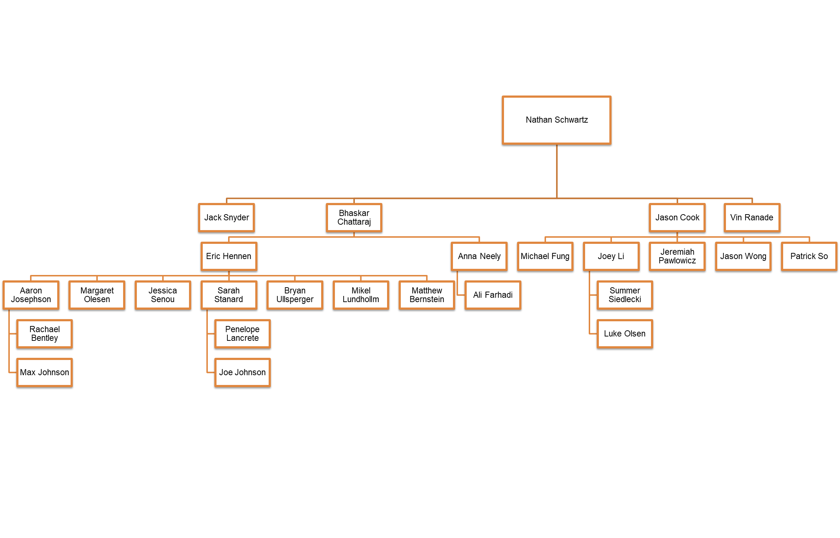
Analytics Department: Structure

Slide 4
Analytics Department: Structure
Nathan is the Global Head of Analytics
Jason is our Chief Actuary
Jack is the Head of Rating Agency Advisory
Bhaskar (BC) leads the Cat Modeling and R&D
Eric leads the Cat Modeling Client Services
Anna leads the R&D initiatives and Real Time Event Management

Slide 5
Analytics Department: What do we do?
Cat Modeling:
Help client manage risk from Catastrophes and create Reinsurance structures
Support brokers in servicing clients and getting NEW clients
Detailed dissection of client portfolio in search of profitable and loss-making segments
Create pro-forma portfolios
Tools such as TigerEye and TigerCQ
Actuarial:
Primarily help clients manage and structure risk for Casualty (Non-property)
Similar as above
Rating Agency Support
Rating Agencies set rules for the insurance companies function properly
Evaluate insurance companies standing with rating agencies
Create scenarios for better financial performance

Slide 6
TIGERISMS
Raise yOUR Standards
Innovate to Differentiate
Originate Big Deals
Execute with Overwhelming Force
2019 Sales Meeting: Be Extraordinary
Team Work is Our Secret Sauce
Differentiate and Innovate
Attack Big Deals
Execute with Overwhelming Force
Originate Big Deals
These are great end goals, but how do we get there? Specifically how does modeling support these strategic initiatives?

Slide 7

Over communicate
Keep It Simple Over-communicating doesn’t mean communicating everything; it means communicating the right things effectively. Having a simple framework is the quickest way to structure your points and give updates. It’ll allow your manager to prioritize what’s important for him/her and hone into areas of interest without having to figure it out. Remember, less is more.
Sync Early and Often If you are unclear of a direction or strategy, sync early and often. Ask lots of follow-up questions, challenge each other, and arrive at the best possible idea. Then apply a simple framework that allows everyone to over-communicate.
It isn’t clutter when you respond to a meeting invite
Copying people on emails gives them the chance to see that activity is happening even if not all the content is read
Overcommunication is a way to record what you’re accomplishing and keep teams involved
It gives people something to react to
https://www.weforum.org/agenda/2015/03/why-you-need-to-over-communicate/

Slide 8

Advertise your capacity and skills
I have time to help
I can get more involved with _____
Keep a side project going that both enhances a particular skill set and benefits the team / company

Slide 9

Raise issues early
Are you anticipating issues with data availability? Timing? Capacity?
Is there a roadblock risk? Any bottle necks?
We preach total responsibility, but that doesn’t mean you can’t lean on your team
If you’re raising an issue, don’t bury in an email – keep it at the top. Bold it.

Slide 10

Don’t send things into the void
Everything you share should have a summary and a so what
If you send something out for review – internally or externally – make sure to follow up if you don’t hear back.

Slide 11
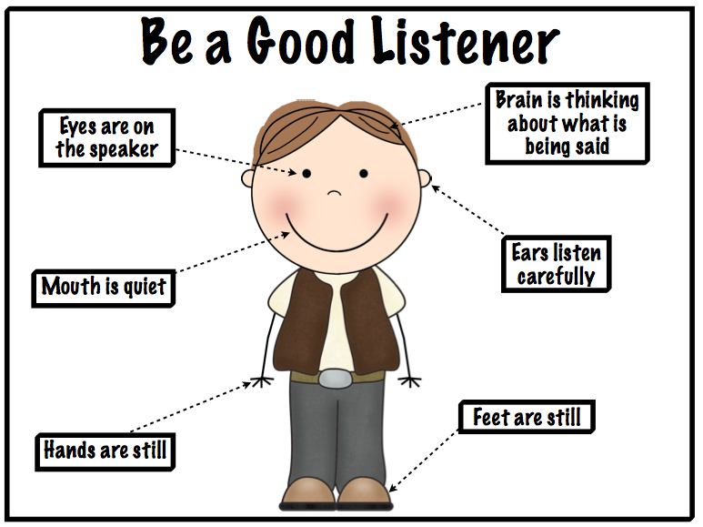

Be a Careful and Creative Problem Solver
Listen to the client (internal or external) carefully to get details of the problem.
If you can, avoid third party versions as that introduces noise.
Frame the question and confirm. Asking the right question is half the solution.
Be creative with solutions and have plan A, B and C towards achieving it based on time and resources.
Seek help from experts while doing it.
Double check to minimize the chance of errors.
Present solutions and clearly lay out pros & cons.
Always try to improve the solution when it is done multiple times.

Slide 12

Keep the purpose in mind
Why is this request being made?
What is the ultimate goal?
Will the output answer the question?

Slide 13
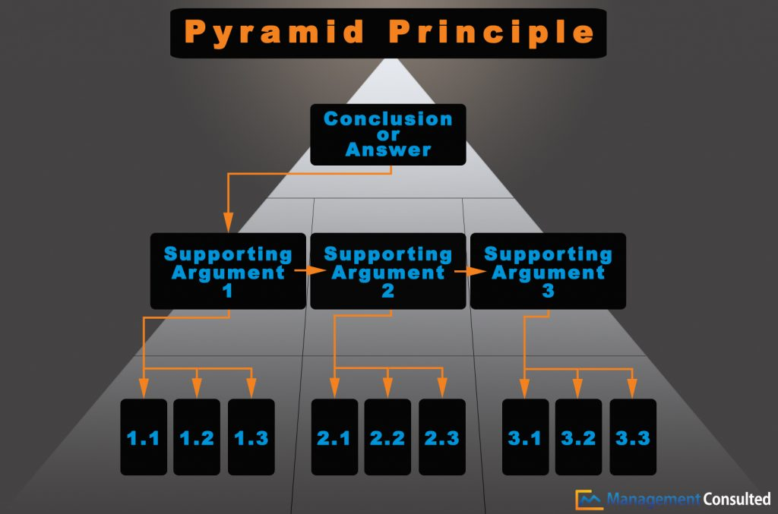
Start with the takeaway
https://managementconsulted.com/pyramid-principle/

Slide 14

People won’t read your emails
Follow up
Call
Put your message in the subject line
Over communicate, don’t send things into the void, and follow the pyramid principle

Slide 15
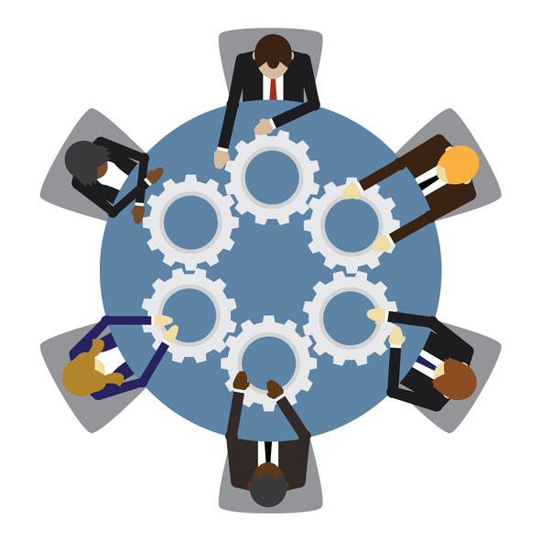
Distributed responsibility = no accountability
We work on teams and send emails to groups
If roles and responsibilities are not clearly assigned to individuals, accountability is lost
Don’t assume others will sort out roles
If you’re unclear of your role, ask

Slide 16

Set deadlines
Set minor and major deadlines and follow up

Slide 17
Ask questions
?
It’s how we learn and avoid unnecessary work

Slide 18
The 10 principles of raising yOUR standards
Over communicate
Advertise your capacity and skills
Raise issues early
Don’t send things into the void
Keep the purpose in mind
Start with the takeaway
People won’t read your emails
Distributed responsibility = no accountability
Set deadlines
Ask questions

Slide 19
